Slide 3
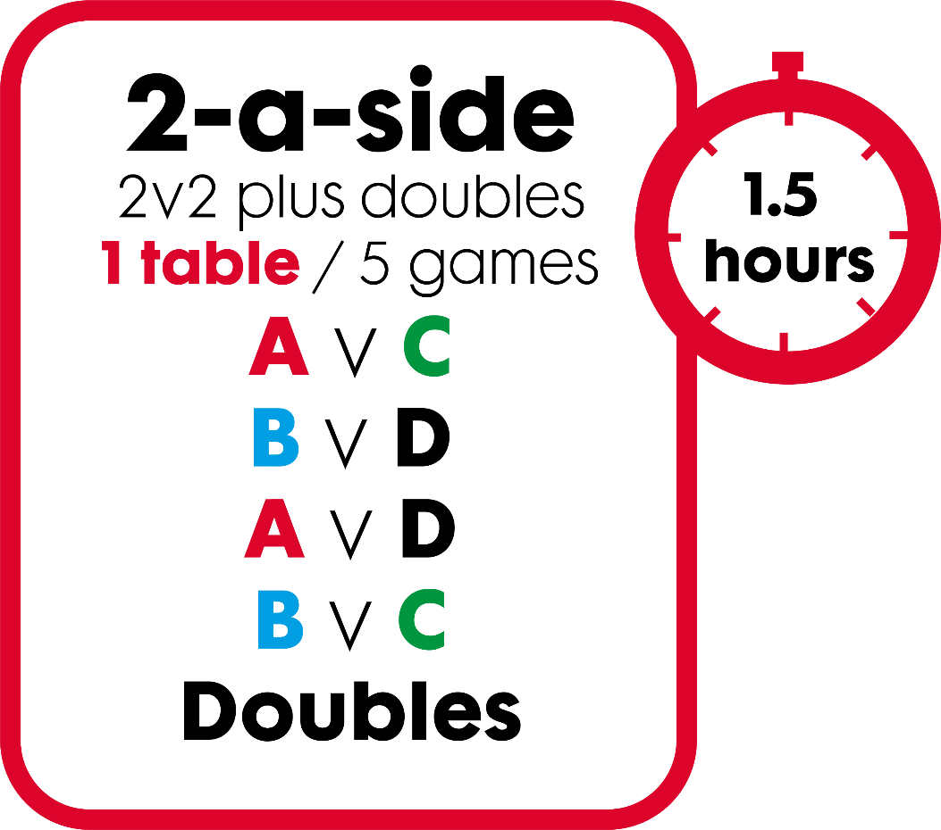
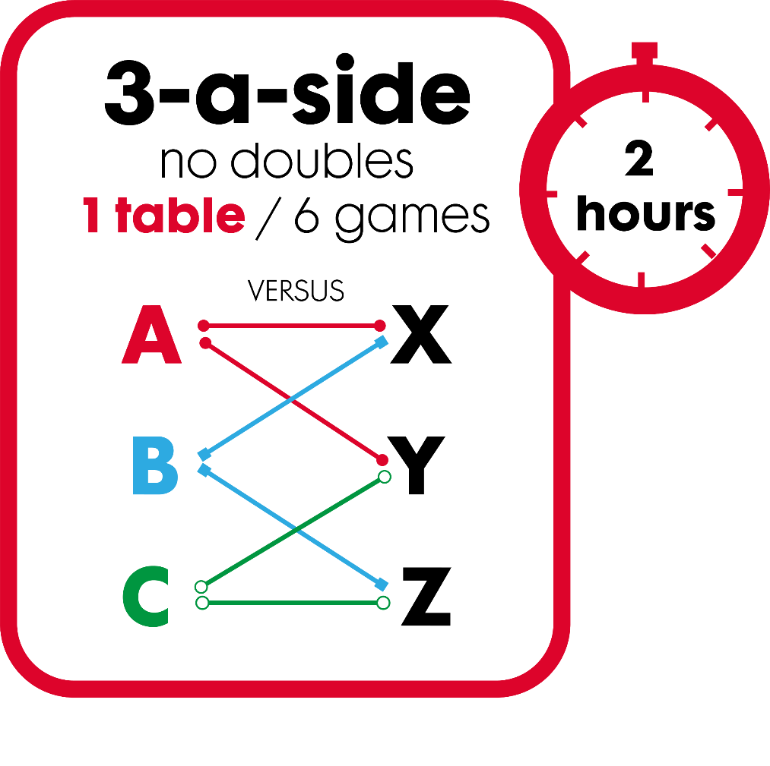
Play in under 2 hours
Variants
Best of 5
Play all 5
Play all 7
3 home players versus 2 away players

Slide 4
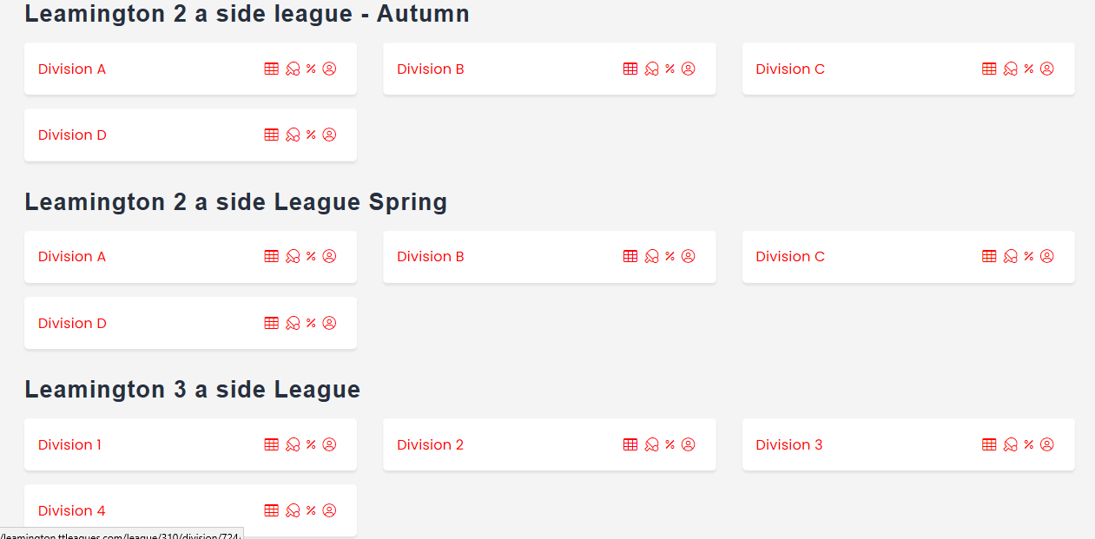
Parallel Division

Slide 5
Suggested venue standards
☑
Guaranteed start
times
☑
Pre-determined warm-up period
☑
Toilets clean
and usable
☑
Safe and adequate heating
☑
Outside
lighting
for winter time

